Slide 15
Support Our Cause at the Tata Mumbai Marathon

Slide 16
Support Our Cause
(Mention the cause/project you want support for)
Write a line about the project
Who will benefit
The scale of the project
The duration of the project
Way the corporate can support the project
Add picture of the beneficiaries or location on the next slide

Slide 17
Glimpses of our (mention project/cause)
Add pictures of the project

Slide 18
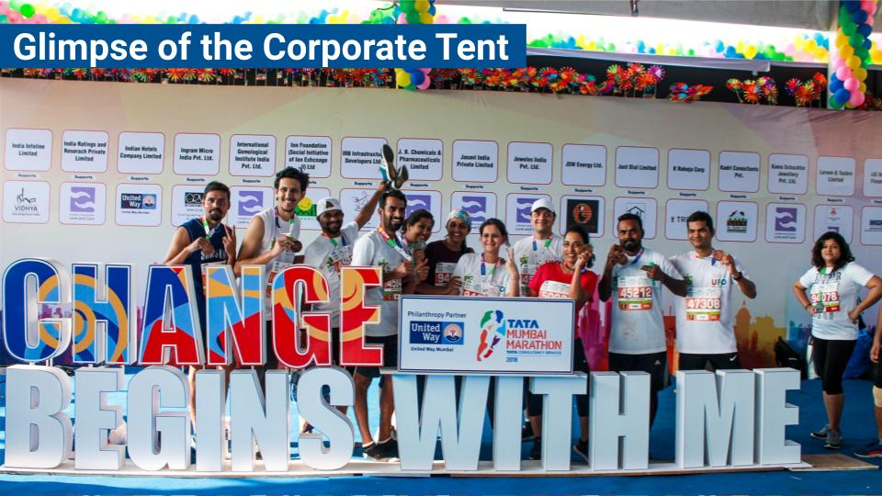

Slide 19
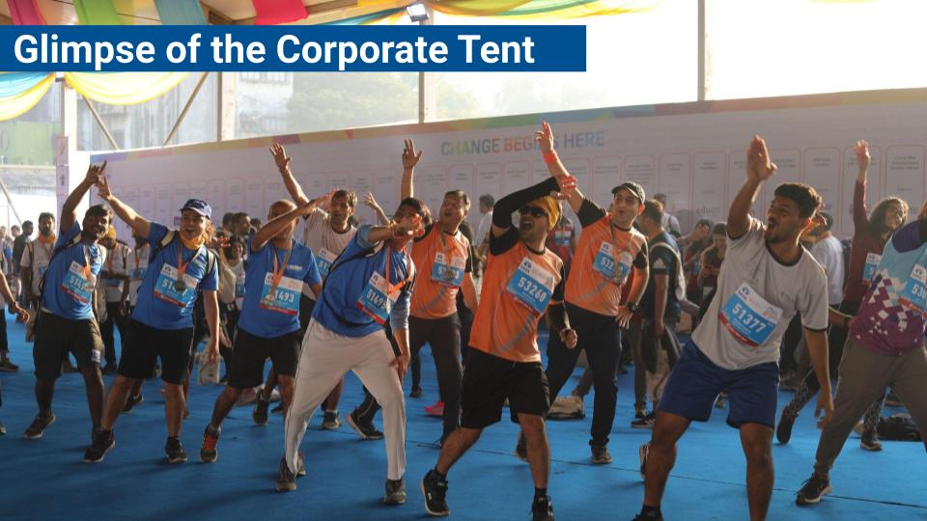

Slide 20
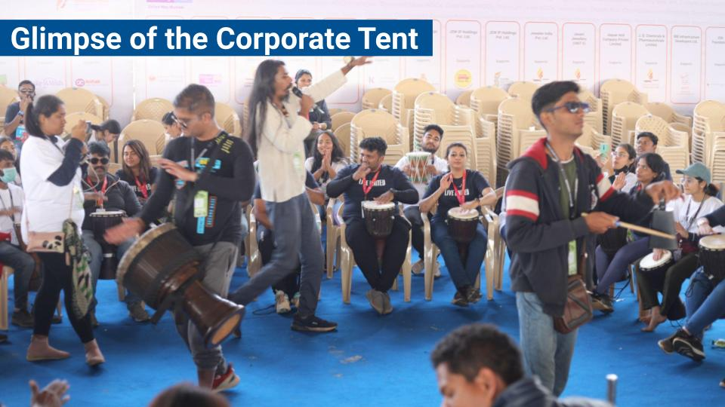

Slide 27
THANK YOU

